Slide 1
坐标与变换

Slide 2

不同类型的坐标系
相机
固定场景
车载记录仪
司机
智能机械臂
...
Makes it important to understand coordinate systems

Slide 3

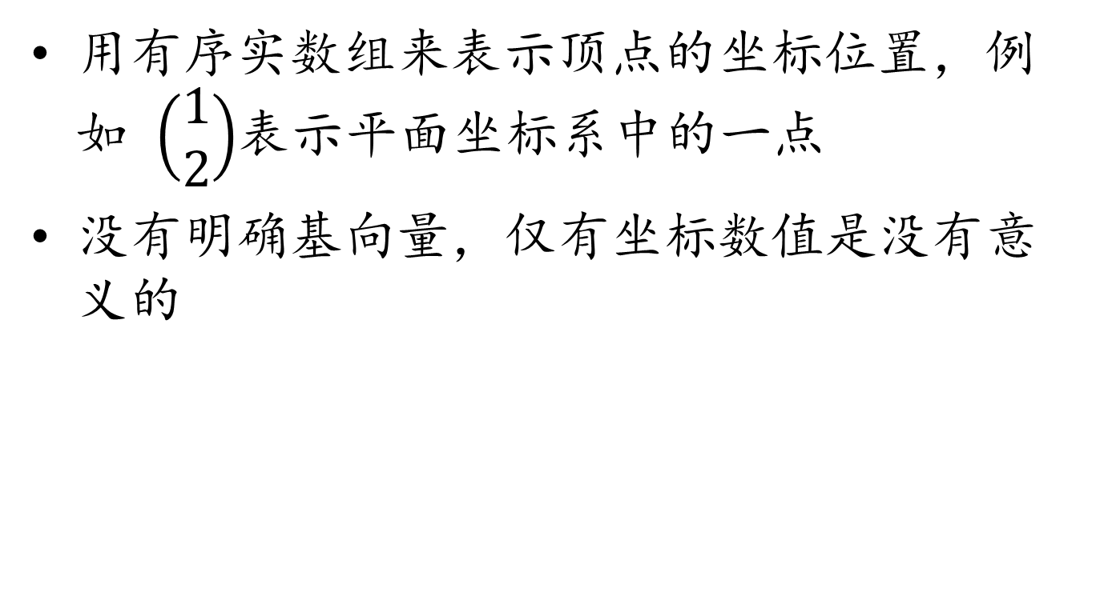

坐标
用有序实数组来表示顶点的坐标位置，例如 $\left(\begin{aligned}1 \\ 2\end{aligned}\right)$表示平面坐标系中的一点
没有明确基向量，仅有坐标数值是没有意义的
红色坐标系下的点$\left(\begin{aligned}1 \\ 2\end{aligned}\right)$
蓝色坐标系下的点$\left(\begin{aligned}1 \\ 2\end{aligned}\right)$

Slide 4

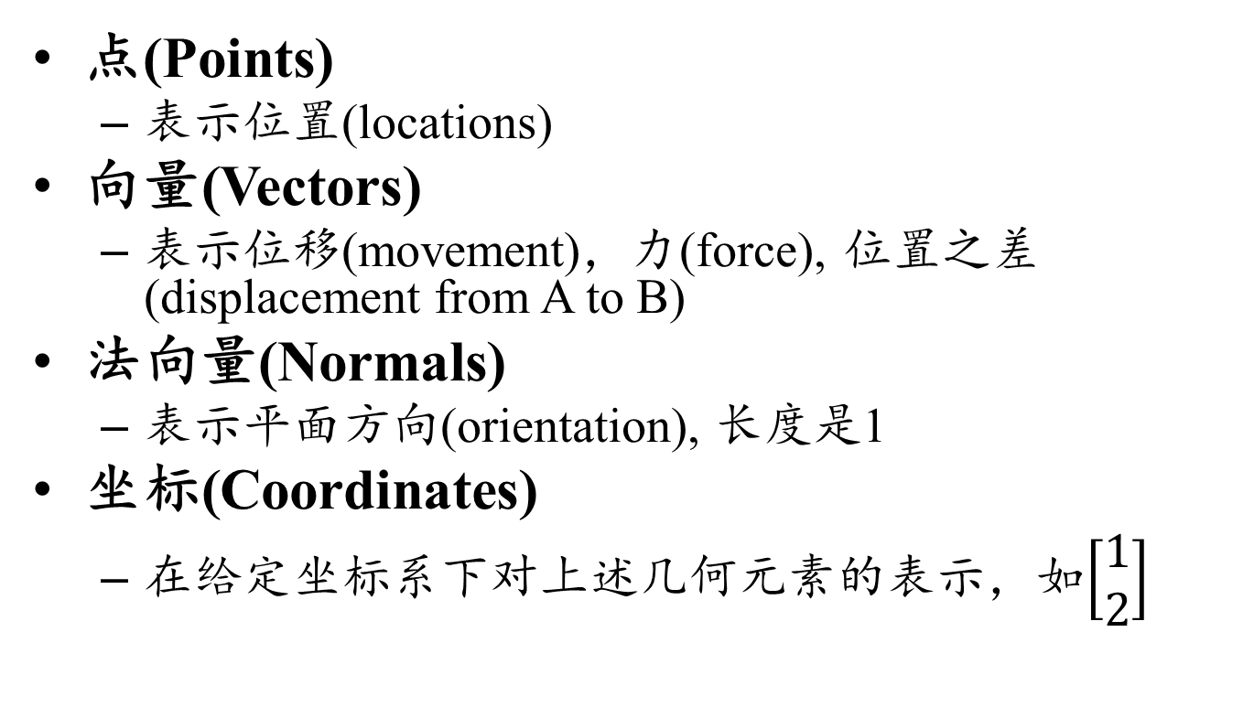
不同的几何元素
点(Points)
表示位置(locations)
向量(Vectors)
表示位移(movement)，力(force), 位置之差(displacement from A to B)
法向量(Normals)
表示平面方向(orientation), 长度是1
坐标(Coordinates)
在给定坐标系下对上述几何元素的表示，如$\left[\begin{aligned}1 \\ 2\end{aligned}\right]$

Slide 5
点和向量是不同的
0向量的基本含义: 没有位移，或者没有力
向量是可以做加法
移动的汽车
点描述了车上元素的位置
向量表示车速和车上不同点的相对位置
If I translate the moving car to a different road
点(location)会变化
向量(speed, distance between points)不变

Slide 6
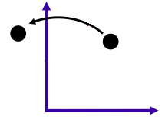
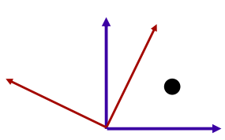
矩阵(Matrix)的两个含义
(At least for geometry)
Transform things
e.g. rotate the car from facing North to facing East
Express coordinate system changes
e.g. given the driver's location in the coordinate system of the car, express it in the coordinate system of the world

Slide 7
课程目的
掌握坐标系的应用方法
掌握坐标基向量的变换
掌握物体的变换
区分点，向量，法向量和它们的坐标

Slide 8
Vectors (linear space)
Formally, a set of elements equipped with addition and scalar multiplication
plus other nice properties
There is a special element, the zero vector
no displacement, no force

Slide 9
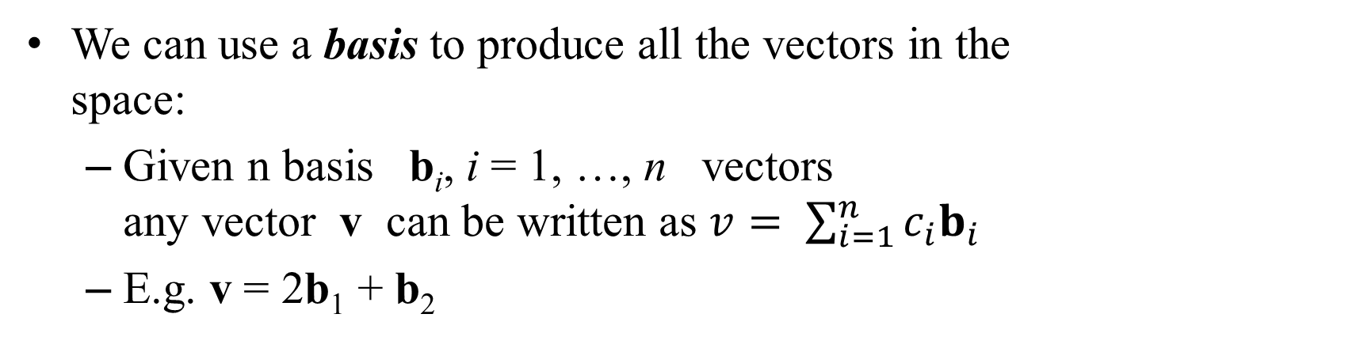
Vectors (linear space)
We can use a basis to produce all the vectors in the space:
Given n basis b_{i}, i = 1, …, n vectors any vector v can be written as $v= \sum_{i=1}^{n}{c_{i}b_{i}}$
E.g. v = 2b₁ + b₂
v
b₂
b₁

Slide 10
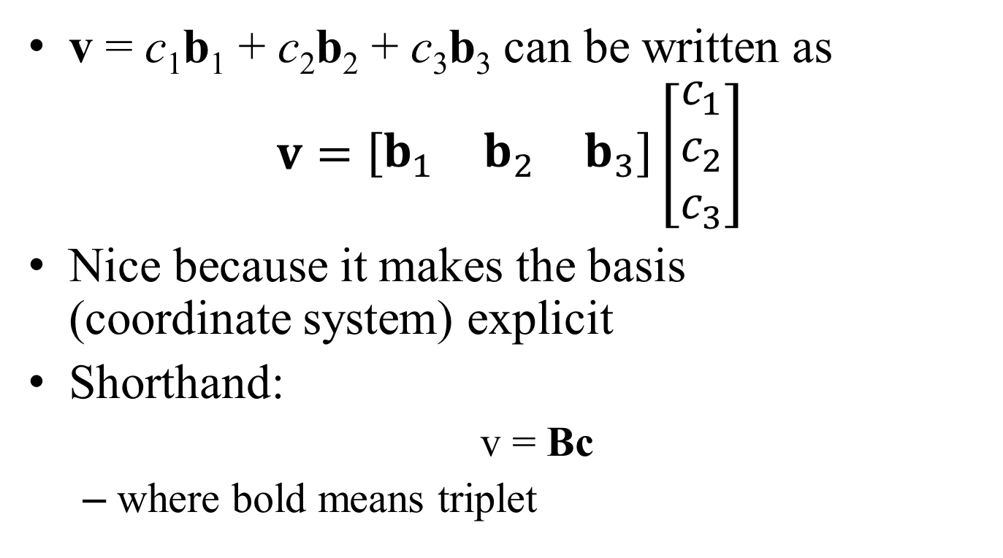
Linear algebra notation
v = c₁b₁ + c₂b₂ + c₃b₃ can be written as
$$v=\left[\begin{matrix}b_{1} & b_{2} & b_{3}\end{matrix}\right]\left[\begin{matrix}c_{1} \\ c_{2} \\ c_{3}\end{matrix}\right]$$
Nice because it makes the basis (coordinate system) explicit
Shorthand:
v = Bc
where bold means triplet

Slide 11
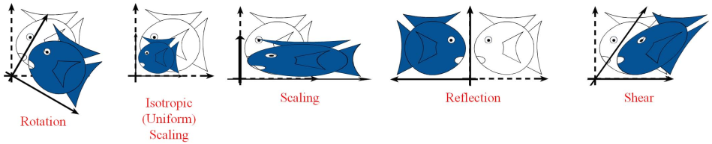
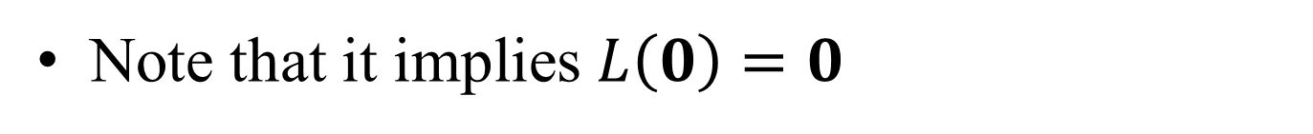
Linear transformations
Transformation L of the vector space, so that
L(u + v) = L(u) + L(v)
L(αu) = αL(u)
Note that it implies $L\left(0\right)=0$

Slide 12

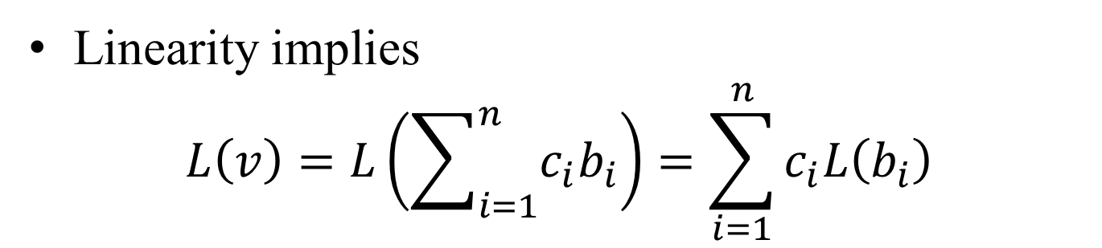
Matrix notation
Linearity implies
$$L\left(v\right)=L\left(\sum_{i=1}^{n}{c_{i}b_{i}}\right)=\sum_{i=1}^{n}{c_{i}L\left(b_{i}\right)}$$
i.e. we only need to know the basis transformation or in algebra notation
$$L\left(\left[\begin{matrix}b_{1} & b_{2} & b_{3}\end{matrix}\right]\left[\begin{matrix}c_{1} \\ c_{2} \\ c_{3}\end{matrix}\right]\right)=\left[\begin{matrix}L\left(b_{1}\right) & L\left(b_{2}\right) & L\left(b_{3}\right)\end{matrix}\right]\left[\begin{matrix}c_{1} \\ c_{2} \\ c_{3}\end{matrix}\right]$$

Slide 13
线性变换
一个变换(或映射)T是线性的，如果它满足：
(i) T(u + v) = T(u) + T(v)
(ii) T(cu) = cT(u)
对于矩阵A，有
A(u + v) = A(u) + A(v)
A(cu) = cA(u)
矩阵变换是线性变换
线性变换但不是矩阵变换的例子？

Slide 14
线性变换的性质
保持矩阵的加法和数乘不变
T(0) = 0
T(0) = T(0u) = 0T(u) = 0
T(cu + dv) = T(cu) + T(dv) = cTu + dTv
上式也可作为线性变换的定义(组合不变性质或叠加原理)
T(c₁v₁ + c₂v₂ + … + c_{p}v_{p})
= c₁T(v₁) + c₂T(v₂) + … + c_{p}T(v_{p})

Slide 15
伸缩变换
T: R² → R² T(x) := rx
验证T是否线性变换
T(cu + dv) = r(cu + dv) = rcu + rdv
= c(ru) + d(rv) = cT(u) + dT(v)

Slide 16
垂直旋转变换
T: R² → R²
计算u, v, u + v在变换T下的像
T(u + v)
T(u)
u + v
v
T(v)
u

Slide 17
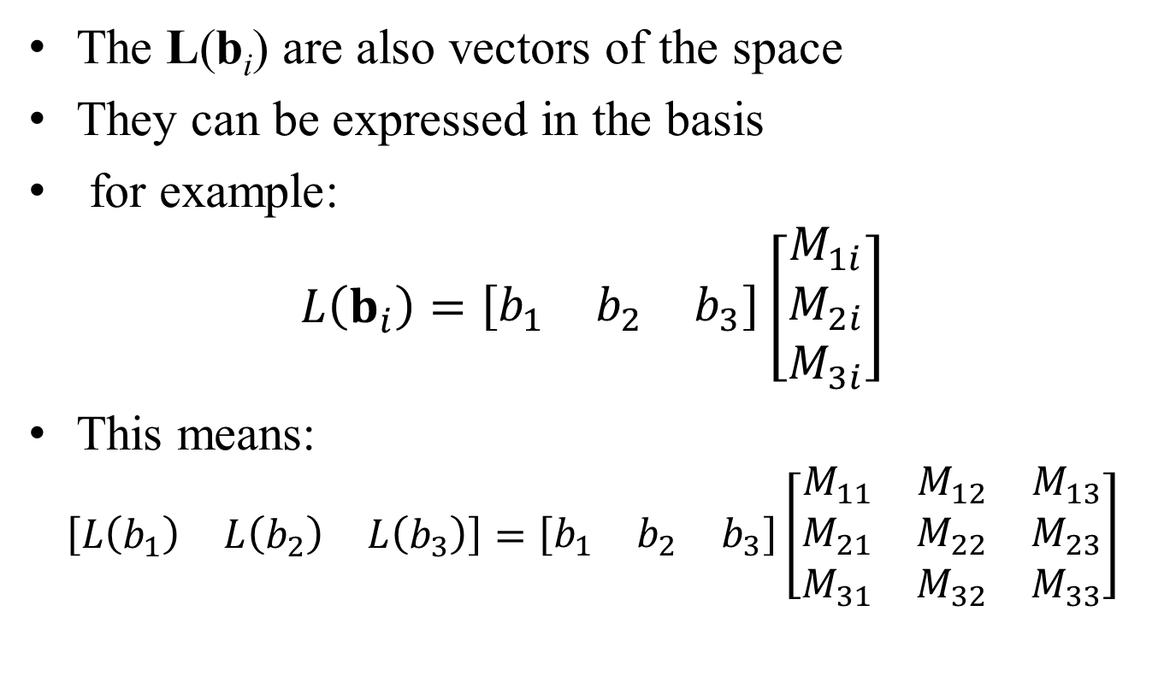
Algebra notation
The L(b_{i}) are also vectors of the space
They can be expressed in the basis
for example:
$$L\left(b_{i}\right)=\left[\begin{matrix}b_{1} & b_{2} & b_{3}\end{matrix}\right]\left[\begin{matrix}M_{1i} \\ M_{2i} \\ M_{3i}\end{matrix}\right]$$
This means:
$$\left[\begin{matrix}L\left(b_{1}\right) & L\left(b_{2}\right) & L\left(b_{3}\right)\end{matrix}\right]=\left[\begin{matrix}b_{1} & b_{2} & b_{3}\end{matrix}\right]\left[\begin{matrix}M_{11} & M_{12} & M_{13} \\ M_{21} & M_{22} & M_{23} \\ M_{31} & M_{32} & M_{33}\end{matrix}\right]$$

Slide 18
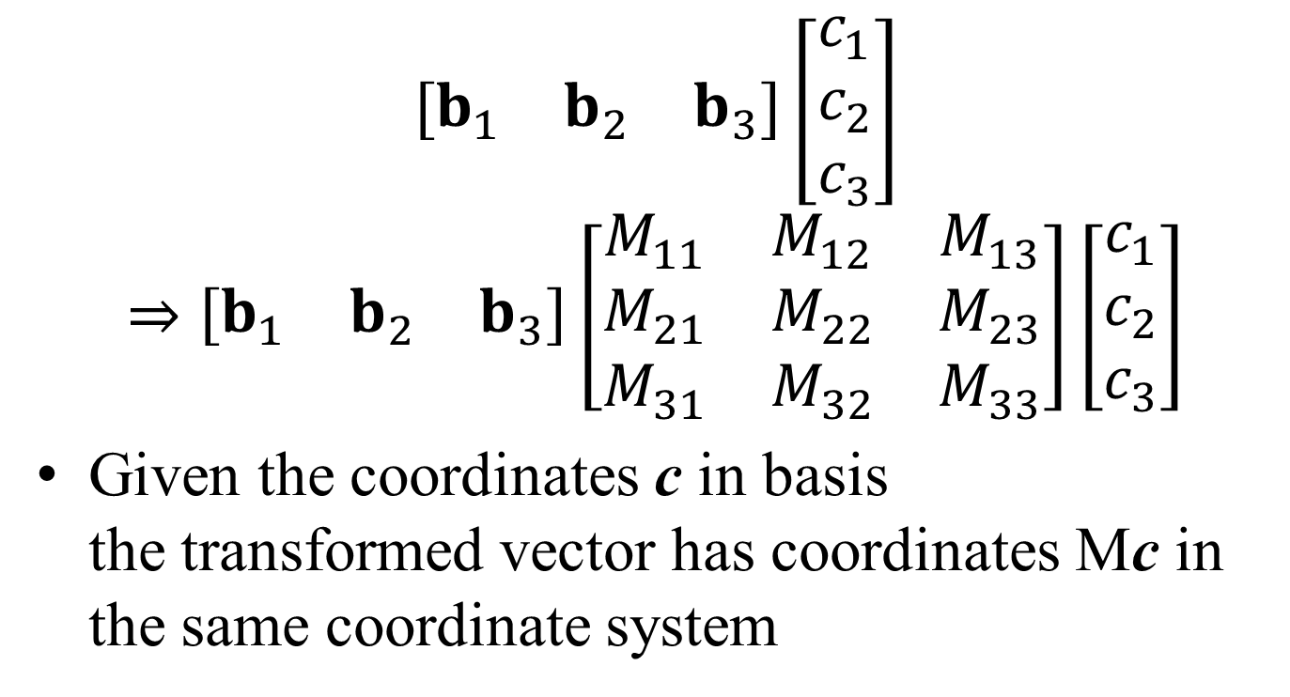
Recap, matrix notation
$$\left[\begin{matrix}b_{1} & b_{2} & b_{3}\end{matrix}\right]\left[\begin{matrix}c_{1} \\ c_{2} \\ c_{3}\end{matrix}\right]$$
$$⇒\left[\begin{matrix}b_{1} & b_{2} & b_{3}\end{matrix}\right]\left[\begin{matrix}M_{11} & M_{12} & M_{13} \\ M_{21} & M_{22} & M_{23} \\ M_{31} & M_{32} & M_{33}\end{matrix}\right]\left[\begin{matrix}c_{1} \\ c_{2} \\ c_{3}\end{matrix}\right]$$
Given the coordinates c in basis the transformed vector has coordinates Mc in the same coordinate system

Slide 19
Why do we care
We need linear algebra
It’s always good to get back to an abstraction that we know and for which smarter people have developed a lot of tools
But we also need to keep track of what basis/coordinate system we use

Slide 20
线性变换矩阵
本节要点：
有限维向量到有限维向量的线性变换都可以写为矩阵变换
通过构造单位基向量(e_{i})的像来构造变换矩阵

Slide 21
线性变换构造示例
二阶单位矩阵I₂ = 的列向量由单位基向量
e₁ = , e₂ = 构成，T是一个从二维到三维的
线性变换，满足T(e₁) = , T(e₂) =
对于x = 计算T(x)

Slide 22
线性变换构造示例

Slide 23
一般线性变换矩阵的构造
设T是从R^{n}到R^{m}的线性映射，存在一个唯一的矩阵A，使得对于R^{n}中的任意一个向量x，有
T(x) = Ax
构造方法：设e_{i}是n维空间中的第i个单位基向量，T(e_{i})是线性变换T作用于e_{i}在R^{m}中的映像，把T(e_{i})写为列向量，并按顺序横向排列即可得到A

Slide 24
一般线性变换矩阵的构造
A称为线性变换T的标准矩阵
标准矩阵A是不是唯一的？为什么？

Slide 25
伸缩变换标准矩阵
伸缩变换T(x) = rx

Slide 26
旋转矩阵构造示例
旋转变换，逆时针旋转角度φ，求标准矩阵
(0, 1)
(-sinφ, cosφ)
(cosφ, sinφ)
φ
φ
(1, 0)

Slide 27
基变换问题
在线性空间R^{n}中，P_{B}和P_{C} 是n×n的矩阵，它们各自的列向量构成V的基向量，且P_{B} = P_{C}T ，其中T是变换矩阵
x∈R^{n}，寻找以P_{B}作为列向量的坐标[x]_{B}和以P_{C}作为列向量的坐标[x]_{C}之间的关系
x = P_{B}[x]_{B}, x = P_{C}[x]_{C}
P_{C}T[x]_{B} = P_{C}[x]_{C}
T[x]_{B} = [x]_{C}
[x]_{B} = T^{–1}[x]_{C}

Slide 28
基变换计算示例
B = {b₁, b₂}, C = {c₁, c₂}
b₁ = 4c₁ +c₂，b₂ = –6c₁ + c₂
x = 3b₁ + b₂，计算[x]_{C}

Slide 29
基变换矩阵
B = {b₁, b₂, …, b_{n}}和C = {c₁, c₂, …, c_{n}}都是n维线性空间V中的基向量组，则B中的每个元素都可以用C的元素线性表示，记
则有
[b₁ b₂ … b_{n}] = [c₁ c₂ … c_{n}]
[x]_{C} = [x]_{B}

Slide 30
基变换矩阵计算示例
计算
[b₁ b₂] = [c₁ c₂]

Slide 31
双向基变换矩阵计算示例
计算 和
[c₁ c₂] = [b₁ b₂]

Slide 32
区分基变换与线性变换
基变换下的x(客观量)不变，基向量(主观参照物)变化，坐标值(主观测量结果)变化
线性变换下的基向量(主观参照物)不变，x(客观量)变为y(客观量)，坐标值(主观测量结果)变化
线性变换从原像x到像y使用一个矩阵(客观变换法则)
基变换的基向量变换使用一个矩阵(主观变换法则)，坐标值变换使用逆矩阵

Slide 33
Change of basis
Critical in computer graphics
From world to car to arm to hand coordinate system
From Bezier splines to B splines and back
problem with basis change:
you never remember which is M or M^{–1} it’s hard to keep track of where you are

Slide 34
Linear Transformations
L(p + q) = L(p) + L(q)
L(ap) = aL(p)
平移变换不是线性变换！
f(p) = p + t
f(ap) = ap + t ≠ a(p + t) = af(p)
f(p + q) = p + q + t
≠ (p + t) + (q + t) = f(p) + f(q)

Slide 35
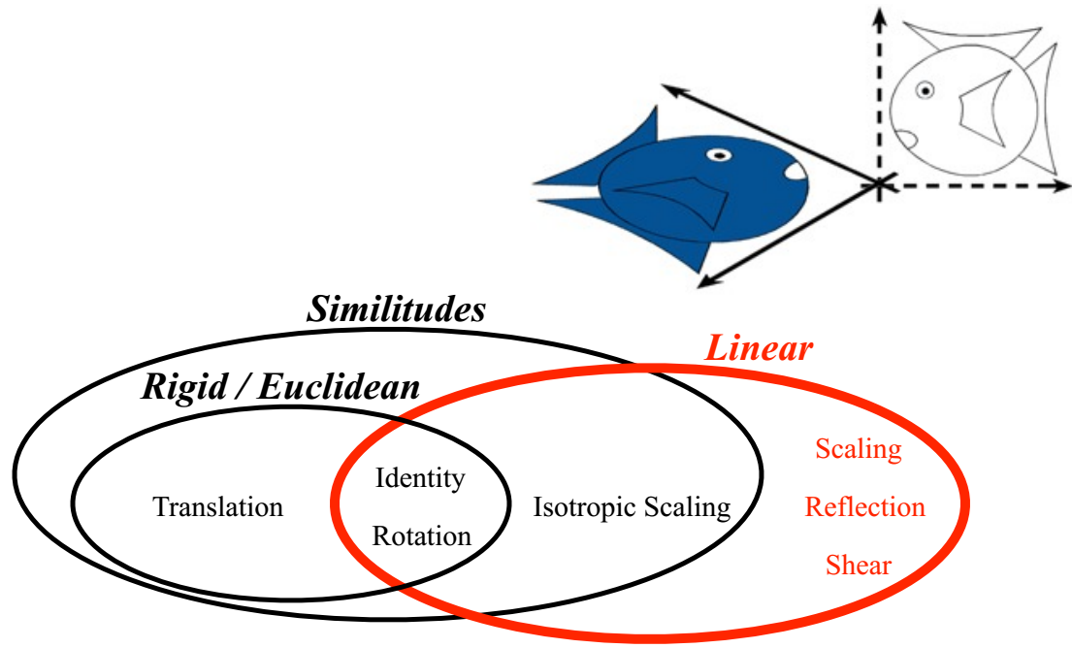
Linear Transformations
L(p + q) = L(p) + L(q)
L(ap) = a L(p)

Slide 36
Points vs. Vectors
A point is a location
A vector is a motion between two points
Adding vectors is meaningful
going 3km North + 4km East = going 5km North-East
Adding points is not meaningful
Boston location + New York location = ?
Multiplying a point by a scalar?
The zero vector is meaningful (no movement)
Zero point ?

Slide 37

仿射空间(Affine space)
Points are elements of an affine space
We denote them with a tilde $\tilde{p}$
Affine spaces are an extension of vector spaces

Slide 38
仿射变换的本质
T(p) = Ap + b
统一的形变A，加整体的平移b
玻璃板上的图案被平行光束投影到另一平面上

Slide 39

Point-vector operations
Subtracting points gives a vector
$$\tilde{p}−\tilde{q}=\vec{v}$$
Adding a vector to a point gives a point
$$\tilde{p}=\tilde{q}+\vec{v}$$

Slide 40
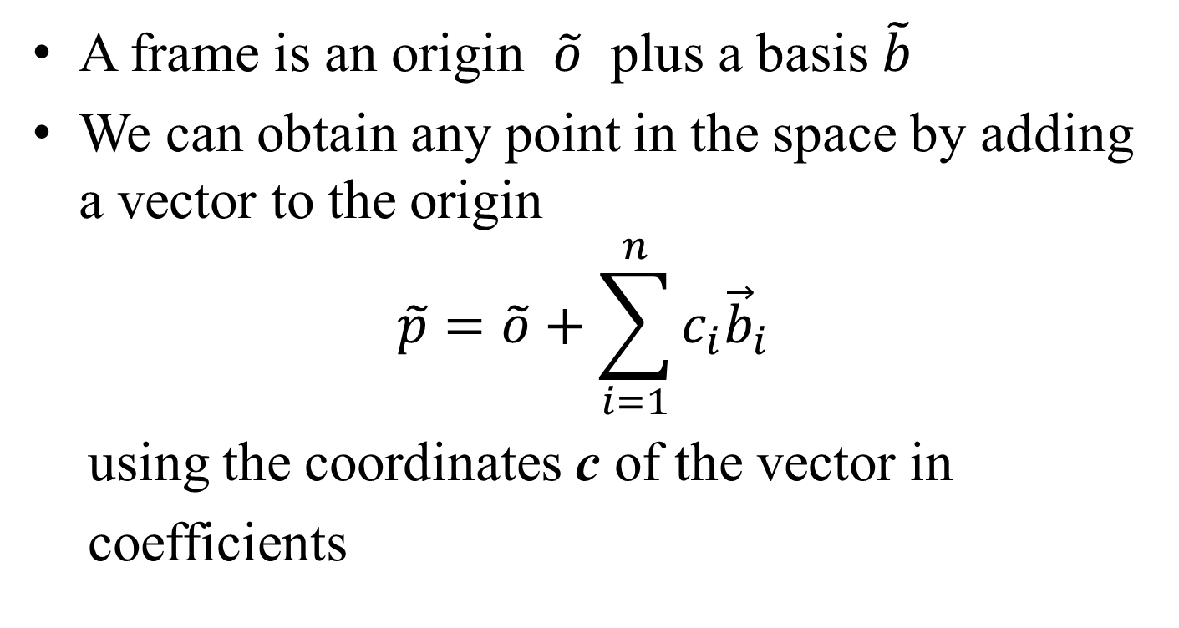
Frames
A frame is an origin $\tilde{o}$ plus a basis $\tilde{b}$
We can obtain any point in the space by adding a vector to the origin
$$\tilde{p}=\tilde{o}+\sum_{i=1}^{n}{c_{i}{\vec{b}}_{i}}$$
using the coordinates c of the vector in
coefficients

Slide 41
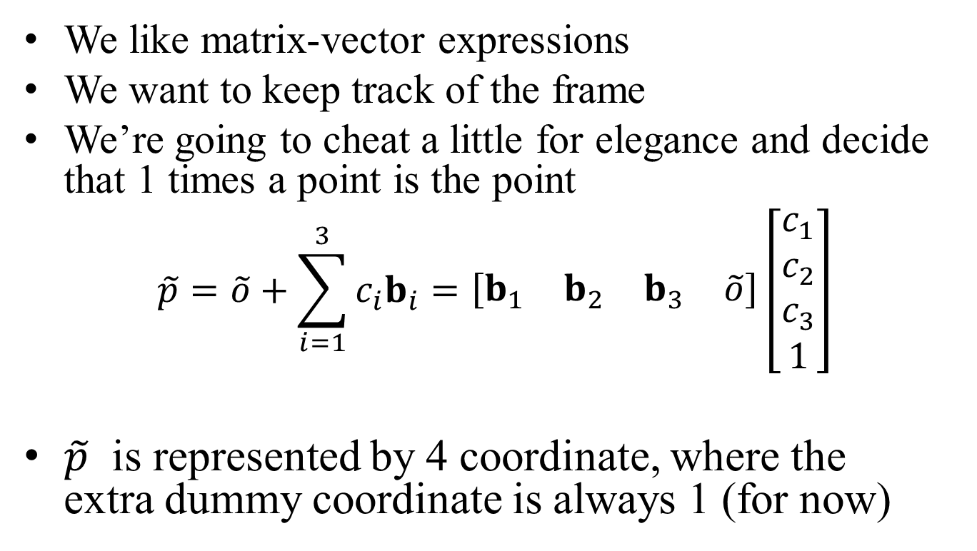
Algebra notation
We like matrix-vector expressions
We want to keep track of the frame
We’re going to cheat a little for elegance and decide that 1 times a point is the point
$$\tilde{p}=\tilde{o}+\sum_{i=1}^{3}{c_{i}b_{i}}=\left[\begin{matrix}b_{1} & b_{2} & b_{3} & \tilde{o}\end{matrix}\right]\left[\begin{matrix}c_{1} \\ c_{2} \\ c_{3} \\ 1\end{matrix}\right]$$
$\tilde{p}$ is represented by 4 coordinate, where the extra dummy coordinate is always 1 (for now)

Slide 42
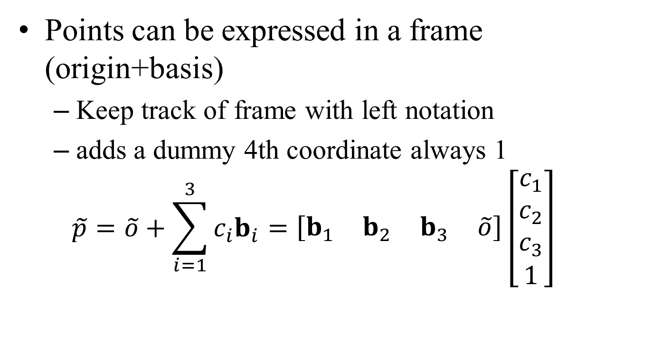
Recap
Points can be expressed in a frame (origin+basis)
Keep track of frame with left notation
adds a dummy 4th coordinate always 1
$$\tilde{p}=\tilde{o}+\sum_{i=1}^{3}{c_{i}b_{i}}=\left[\begin{matrix}b_{1} & b_{2} & b_{3} & \tilde{o}\end{matrix}\right]\left[\begin{matrix}c_{1} \\ c_{2} \\ c_{3} \\ 1\end{matrix}\right]$$

Slide 43
叉积的几何定义
a×b
b
a
在三维空间中向量a与向量b组成的平行四边形的面积乘以与它们垂直的单位法向量定义为a与b的叉积，写为a×b，其中向量a，向量b与a×b三个向量的位置要与右手坐标系一致

Slide 44
叉积的坐标表示
坐标基向量的叉积性质
e_{x} = (1, 0, 0), e_{y} = (0, 1, 0), e_{z} = (0, 0, 1)
e_{x}×e_{y} = e_{z}, e_{y}×e_{z} = e_{x}, e_{z}×e_{x} = e_{y}
e_{y}×e_{x} = –e_{z}, e_{z}×e_{y} = –e_{x}, e_{x}×e_{z} = –e_{y}
u = (x_{u}, y_{u}, z_{u}) = x_{u}e_{x} + y_{u}e_{y} + z_{u}e_{z}
v = (x_{v}, y_{v}, z_{v}) = x_{v}e_{x} + y_{v}e_{y} + z_{v}e_{z}
u×v = (x_{u}e_{x} + y_{u}e_{y} + z_{u}e_{z})×(x_{v}e_{x} + y_{v}e_{y} + z_{v}e_{z})

Slide 45
叉积的坐标表示
u×v = (x_{u}e_{x} + y_{u}e_{y} + z_{u}e_{z})×(x_{v}e_{x} + y_{v}e_{y} + z_{v}e_{z})
= x_{u}x_{v}e_{x}×e_{x} + y_{u}x_{v}e_{y}×e_{x} + z_{u}x_{v}e_{z}×e_{x}
+ x_{u}y_{v}e_{x}×e_{y} + y_{u}y_{v}e_{y}×e_{y} + z_{u}y_{v}e_{z}×e_{y}
+ x_{u}z_{v}e_{x}×e_{z} + y_{u}z_{v}e_{y}×e_{z} + z_{u}z_{v}e_{z}×e_{z}
= x_{u}x_{v}0 – y_{u}x_{v}e_{z} + z_{u}x_{v}e_{y}
+ x_{u}y_{v}e_{z} + y_{u}y_{v}0 – z_{u}y_{v}e_{x}
– x_{u}z_{v}e_{y} + y_{u}z_{v}e_{x} + z_{u}z_{v}0
= (y_{u}z_{v} – z_{u}y_{v})e_{x} + (z_{u}x_{v} – x_{u}z_{v})e_{y} + (x_{u}y_{v} – y_{u}x_{v})e_{z}
= (y_{u}z_{v} – z_{u}y_{v}, z_{u}x_{v} – x_{u}z_{v}, x_{u}y_{v} – y_{u}x_{v})

Slide 46
叉积计算练习
a = (1, 2, 3)
b = (4, 5, 6)
a×b = (1, 2, 3) × (4, 5, 6)
= (2×6 – 3×5, 3×4 – 1×6, 1×5 – 2×4)
= (–3, 6, –3)
记忆规律：乘积列的计算要刨除对应的因子列，剩余部分外侧相乘，内侧相乘，一三项外正内负，第二项内正外负

Slide 47
叉积的应用
已知平面过点P₀(x₀, y₀, z₀)，且u和v都平面上的向量，计算平面的方程
设平面的方程为
Ax + By + cZ + D = 0
则n = (A, B, C)是平面的法向量，满足：
n = u × v
P₀在平面上，因而D满足：
Ax₀ + By₀ + cZ₀ + D = 0

Slide 48
叉积的应用
已知下面两个平面的方程：
A₁x + B₁y + C₁z + D₁ = 0
A₂x + B₂y + C₂z + D₂ = 0
计算它们交线的方向t
(A₁, B₁, C₁), (A₂, B₂, C₂)是两个平面的法向量
交线与两个平面都垂直，因而
t = (A₁, B₁, C₁) × (A₂, B₂, C₂)

Slide 49
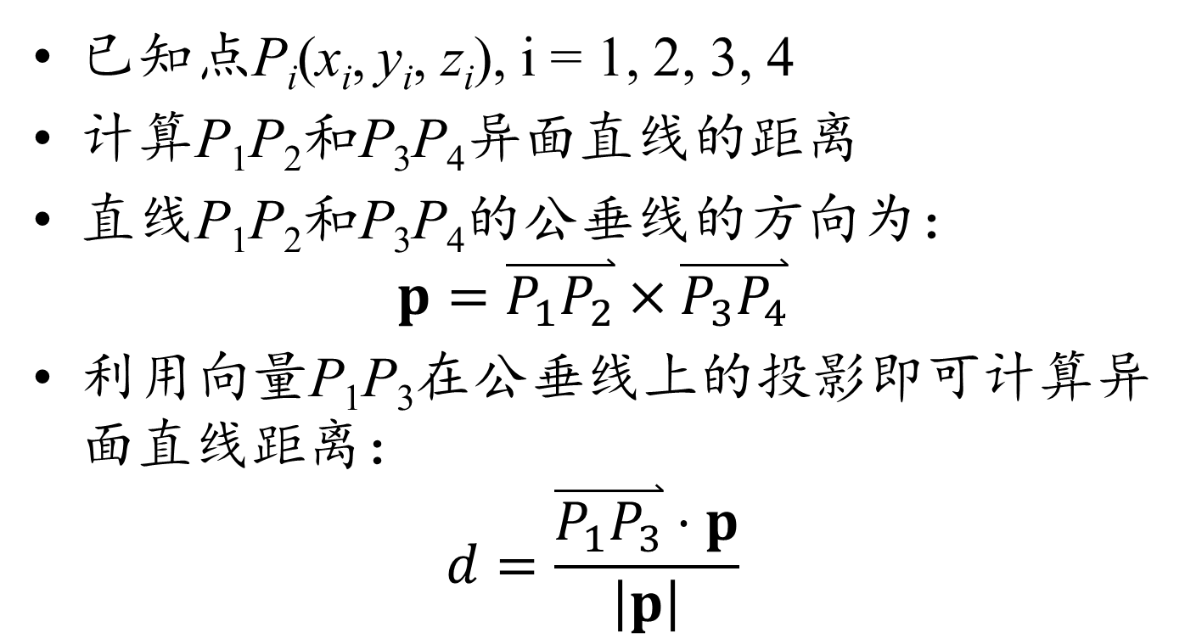
叉积的应用
已知点P_{i}(x_{i}, y_{i}, z_{i}), i = 1, 2, 3, 4
计算P₁P₂和P₃P₄异面直线的距离
直线P₁P₂和P₃P₄的公垂线的方向为：
$$p=\overset{⃑}{P_{1}P_{2}}×\overset{⃑}{P_{3}P_{4}}$$
利用向量P₁P₃在公垂线上的投影即可计算异面直线距离：
$$d=\frac{\overset{⃑}{P_{1}P_{3}}⋅p}{\left|p\right|}$$

Slide 50
三维向量叉积的行列式表示
设v₁ = (x₁, y₁, z₁)^{T}, v₂ = (x₂, y₂, z₂)^{T}
则有
分布规律：坐标分量x, y, z循环排列，对应位置剃除对应分量，剩下分量的按照循环次序填入行列式
叉积的性质：
v₁×v₂ = –v₂ × v₁
v₁×v₁ = 0

Slide 51
三个三维向量的混合积
设v₁ = (x₁, y₁, z₁)^{T}, v₂ = (x₂, y₂, z₂)^{T}, v₃ = (x₃, y₃, z₃)^{T}
(v₁×v₂)·v₃

Slide 52
混合积的几何意义和性质
C(x₃, y₃, z₃)
B(x₂, y₂, z₂)
D
O
A(x₁, y₁, z₁)
(v₁×v₂)·v₃ = (v₂×v₃)·v₁ = (v₃×v₁)·v₂
= – (v₂×v₁)·v₃ = – (v₃×v₂)·v₁ = – (v₁×v₃)·v₂

Slide 53
拉格朗日恒等式
u₁ = (x₁, y₁, z₁)^{T}, u₂ = (x₂, y₂, z₂)^{T}, u₃ = (x₃, y₃, z₃)^{T}, u₄ = (x₃, y₃, z₃)^{T},
计算(u₁×u₂)·(u₃×u₄)
记：
v = u₁×u₂ = (x_{v}, y_{v}, z_{v})^{T}
w = u₃×u₄ = (x_{w}, y_{w}, z_{w})^{T}
则有
v·u₃ = 0, v·u₄ = 0
w·u₁ = 0, w·u₂ = 0

Slide 54
拉格朗日恒等式
记M₁ = (u₁ u₂ w), M₂ = (u₃ u₄ v)
则v·w = |M₁| = |M₂|，|M₁^{T}M₂| = |M₁||M₂| = (v·w)²

Slide 55
拉格朗日恒等式
两边取行列式，右边按最后一列展开
由此得到
由此得出拉格朗日恒等式：
(u₁×u₂)·(u₃×u₄) = (u₁·u₃)(u₂·u₄) – (u₁·u₄)(u₂·u₃)

Slide 56
二重叉积展开式
u×v
w
v
u
(u×v)×w
u, v, w∈R³，
(u×v)⊥u, (u×v)⊥v，((u×v)×w)⊥(u×v)
w∈Span{u, v}
(u×v)×w = λu + μv

Slide 57
二重叉积展开式
u×v
w
v
u
(u×v)×w
((u×v)×w)·u = (w×u)·(u×v)
= (w·u)(u·v) – (w·v)(u·u)
((u×v)×w)·v = (w×v)·(u×v)
= (w·u)(v·v) – (w·v)(v·u)

Slide 58
二重叉积展开式
λu + μv = (u×v)×w
λ(u·u) + μ(u·v) = (w·u)(u·v) – (w·v)(u·u)
λ(u·v) + μ(v·v) = (w·u)(v·v) – (w·v)(v·u)
λ = –v·w, μ = u·w
由此导出二重叉积展开式：
(u×v)×w = (u·w)v – (v·w)u
u×(v×w) = (w·u)v – (u·v)w

Slide 59
向量方程求解示例
计算满足x×a = b, x·a = c的向量x，其中a和b是已知向量，c是已知数
解：
x×a = b
a×(x×a) = a×b
|a|²x – (x·a)a = a×b
x = (a×b + (x·a)a) / |a|² = (a×b – ca) / |a|²

Slide 60
向量方程求解示例
在三维空间中已知x·α = a，x·β = b，|x| = r，计算x，其中α和β是已知向量，a, b和r是已知数
解：设α×β = n
x×n = x×(α×β) = (β·x)α – (α·x)β = bα – aβ
(x·n)² + (x×n)² = |x|²|n|²
n×(x×n) = (n·n)x – (x·n)n
x = (n×(x×n) + (x·n)n)/|n|²

